Slide 1
Exploring Severs
Web Development Day 2

Slide 2
Today’s Objectives
By the end of class, you will be able to:
Define caching and distinguish between private and public caches.
Explain the process behind web cache poisoning
Explain how cookies and sessions provide ways for servers to remember specific information about the client.
Describe two common session attacks: Impersonation and forgery.
Distinguish between client-side and server-side validation.
Explain how session hijacking is an impersonation attack on server sessions.
Discuss why servers often store sensitive, larger, and long-term data in sessions instead of cookies.
Inspect weak session IDs generated by a live web app.

Slide 3
Cache

Slide 4

Caching is the process of browsers and servers saving and re-using responses in order to reduce load time.
Notes:
Explain that caching is a process in which browsers and/or servers save responses to previous requests for later reuse.
For example, if a user requests the /index.php resource from a given website, the browser, or an intermediate content delivery server, can cache the response.
This means that, the next time the client requests that same /index.php file, the browser or server can simply send the same response it did earlier, without having to completely reload the resource from the destination server.
Remind students of the waterfall charts they saw earlier, and point out that this mechanism allows us to attenuate or avoid wait times associated with TTFB (time to first byte) and content download.

Slide 5





Private and Public Caches
There are two types of Caches: Private and Public
Private Cache: Local cache that servers a single, dedicated user.
While not as scalable as public caches, they offer immense benefits for single users.
Public Cache: Distributed cache that serves popular files to several users.
Often sit between you and the destination server you’re requesting resources from.

Slide 6
Private and Public Caches
When it is best to use Private, Public or No Cache.
Private Cache
Response with cookies
Resources provided by HTTPS protocol
Certain resources only available for one specific user or authorized users.
Only used by one client
Public Cache
Popular demand (requested often)
Not changed often
No cache
Frequently changed objects
Time sensitive info (POST request, dynamic info)

Slide 7
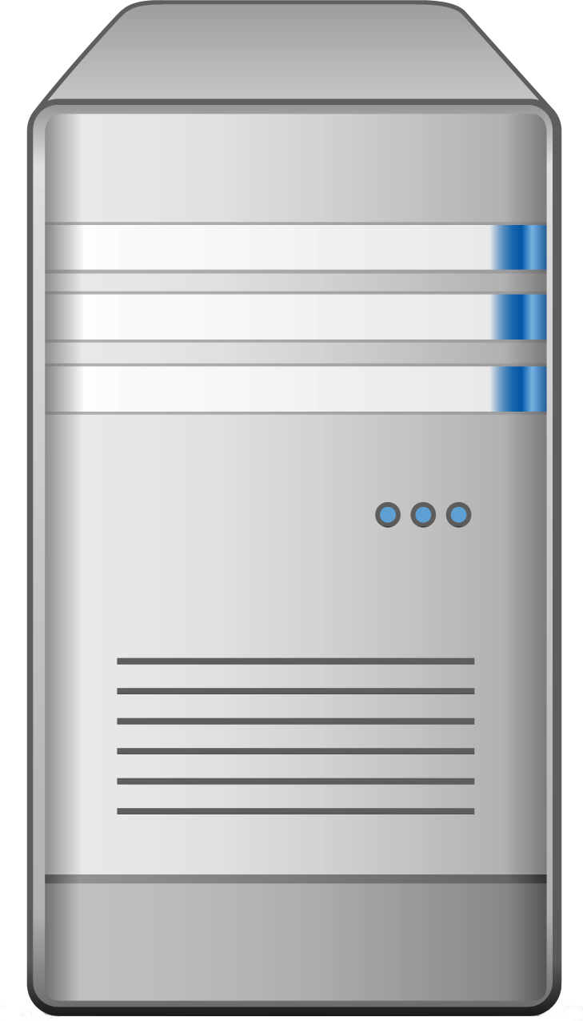

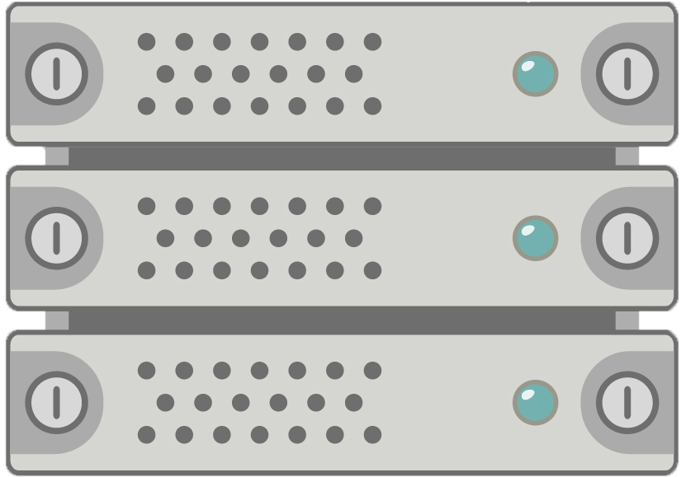
Forward and Reverse Server Proxy Caching
In forward cache proxy, requests coming from the client machine (left) that go out to the internet are cached by the forward proxy cache server
In reverse cache proxy, requests coming in to the servers (right) from users on the internet (not on the same network as the servers) are cached by the reverse cache server
In this diagram, the client machine is requesting a web page hosted on the web server.
The client’s forward cache proxy will go out to the internet on behalf of the client and retrieve the web page.
As the request comes into the network, the reverse proxy will cache the request after it provides the request to the forward cache proxy.
Now both the forward and reverse cache proxy servers will have the request cached for future use.
Internet
Client
Forward Cache Proxy
Reverse Cache Proxy
Servers

Slide 8
Commonly Caches Status Codes
Caches commonly store responses to the status codes.
200 OK: responses are cached because resources don’t (or, shouldn’t) move frequently. If the resource lived at a given URL in the past, it probably lives there now.
404 NOT FOUND: responses are cached because resources that don’t exist at an endpoint are unlikely to suddenly appear.
301 MOVED PERMANENTLY responses indicate that the URL used to request the resource is “invalid”, in the sense that the resource now lives at a different link, and will never “move back” to the URL used in the request.
206 PARTIAL CONTENT: responses are cached under the same logic as 200 OK responses.

Slide 9
Cache-Control
Cache-control is an HTTP header used to specify browser caching policies in both client requests and server responses. Directives include:
Max-Age defines in seconds the mount of time it takes for a cached copy of a resource to expire.
No-Cache indicated that a browser may cache a response, but first must submit a validation request to an origin server.
No-Store: Browsers aren’t allowed to cache a response and instead must pull it from the server each time it’s requested.
Public: The public response directive indicated that a resource can be cached by any cache.
Private: The private response directive indicates that a resource is user specific, it can still be cached out, but only on a client device.

Slide 10
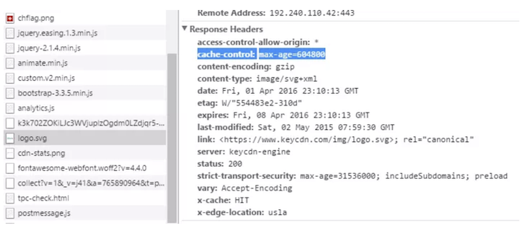
Cache Control
Servers can use the Cache-Control header to instruct clients and intermediary servers as to whether they should cache the response it appears in, and if so, how.
Cache-control directives determine who caches the response, under what conditions and for how long.

Slide 11
Cache Control
The Cache-Control header lets servers specify which resources to cache.
HTTP/1.1 200 OK
Date:
Server: Apache/2.4.7 (Ubuntu)
X-Powered-By: PHP/5.5.9-lubuntu4.21
Cache-Control: no-cache
Set-Cookie: SESSID=8toks; httponly
Content-Encoding: gzip
Content-Length: 698
function getStats(event) {
…

Slide 12
Content Delivery Networks
The variety of caching headers can make manual cache management overwhelming.
Content delivery networks (CDN) are the transparent backbone of the Internet in charge of content delivery.
CDNs allow for granular cache policy management through a user-friendly dashboard, relieving you of the need to manually tweak individual headers.

Slide 13
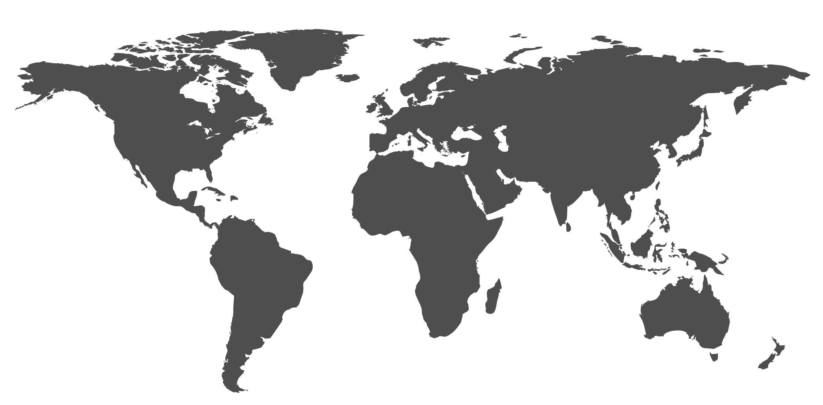
Content Delivery Networks
CDNs augment the browser caching process using proxies.
3 sec
End User
Origin server

Slide 14
Content Delivery Networks
CDNs augment the browser caching process using proxies.
1 sec
End User
Cache Server
Origin server
Cache Server
Cache Server

Slide 15
Web Cache Poisoning
In the next activity, we’ll look at web cache poisoning.
1. User browes to http://example.com/home.php/logo.png
User
2.
http://example.com/home.php/logo.png returns the content of http://example.com/home.php/logo.png and is being cached on the proxy server.
3. Attacker browes to tohttp://example.com/home.php/logo.png
4. The user’s home.php page returns from the proxy server.
Attacker

Slide 16
Activity: Web Cache Poisoning
In this activity, you will research an important attack called Web Cache Poisoning.
Instructions sent via Slack.
15 Minutes

Slide 17
Web Cache Poisoning

Slide 18
Cookies and Sessions
Notes:
Point out that HTTP was originally designed to facilitate the request/retrieval of individual documents, such as index.html, etc.
Explain that, after a server responds to a request for a document, it doesn’t “remember” anything about the request, as the assumption was that requests would only be for individual documents (or small quantities of them).
An implication of this is that servers running over HTTP don’t “remember” information about clients that modern applications need to function. Examples include:
-Authentication: Servers can’t remember if a user has logged in using HTTP alone.
-Locale/Theme Preferences: Servers wouldn’t be aware of application-specific user preferences using HTTP alone.
Explain that cookies and sessions are two tools that servers can use to facilitate processing that requires this kind of data.

Slide 19

HTTP Request
HTTP requests don’t contain information about the application you’re using.
Has implications for the following functionalities:
Authorization: How do you remember if the current user is logged in?
Authentication: How do you know that the current user is who they say they are?
User preferences: How do you remember which time zone the user wants to use?
Cookies and sessions are two mechanisms that can”remember” this
kind of information about a given user across requests.
Notes:
An implication of this is that servers running over HTTP don’t “remember” information about clients that modern applications need to function. Examples include:
-Authentication: Servers can’t remember if a user has logged in using HTTP alone.
-Locale/Theme Preferences: Servers wouldn’t be aware of application-specific user preferences using HTTP alone.

Slide 20
Cookies
Cookies are pieces of key/value data that client can send to servers to provide information about the identity of the user who sent it.
The client sends a request to a server.
The server responds with the requested data, a a cookie with the Set-Cookie header.
The client then stores these cookies as strings in a local database.
When the client sends a request to that server later, it sends the cookies as well.

Slide 21
Cookies for Authentication
A server needs to remember that the user is logged in, and should not redirect their request for, e.g. https://private.site/personal to https://private.site/login.
The user logs in via an HTTP POST request to, e.g., https://private.site/login
The server authenticates the user, and sends an HTTP response with the protected data at https://private.site/personal
In the response, it sets a header, which might look like: Set-Cookie: authenticated=true
When the browser makes subsequence requests to https://private.site, it will always send the authenticated cookie in its HTTP request.
This way, the server can check the value of authenticated to verify that requests for private resources come from legitimate users.

Slide 22
A session is data used by a server to remember details about a user.
Notes:
Emphasize that cookies are stored on the client.
This makes them vulnerable to any attack that exposes data on the client, and also means that servers can’t ensure they’ll always get the right cookies when they need them (this is dependent on the browser, not the server).
Sessions are data stored on servers that remember information about users.
Emphasize that sessions are not sent to users They’re private to the server.
This makes them suitable for highly sensitive and/or essential data.

Slide 23
Session IDs
When a server creates a session, it gives that session an ID. It then sends that ID to the client in a cookie
On subsequent requests, the browser sends the cookie to the server, and the server uses the ID to look up the user’s session.
Server Sends
Set-Cookie: PHPSESSID=100
Set-Cookie: security=high
Browser Stores
“PHPSESSID=100;security=high”

Slide 24
A closer look at Session IDs
Servers that use sessions must still set a cookie containing the user session ID.
User logs in and interacts with applications via HTTP request
Server creates a session and stores data about the user.
Server sends HTTP response with a Set-Cookie: sessionid=exampleBadSessionId header.
On subsequent requests, the client sends the cookie sessionid=exampleBadSessionId, and the server uses the value exampleBadSessionId to look up the user's session in its database.

Slide 25
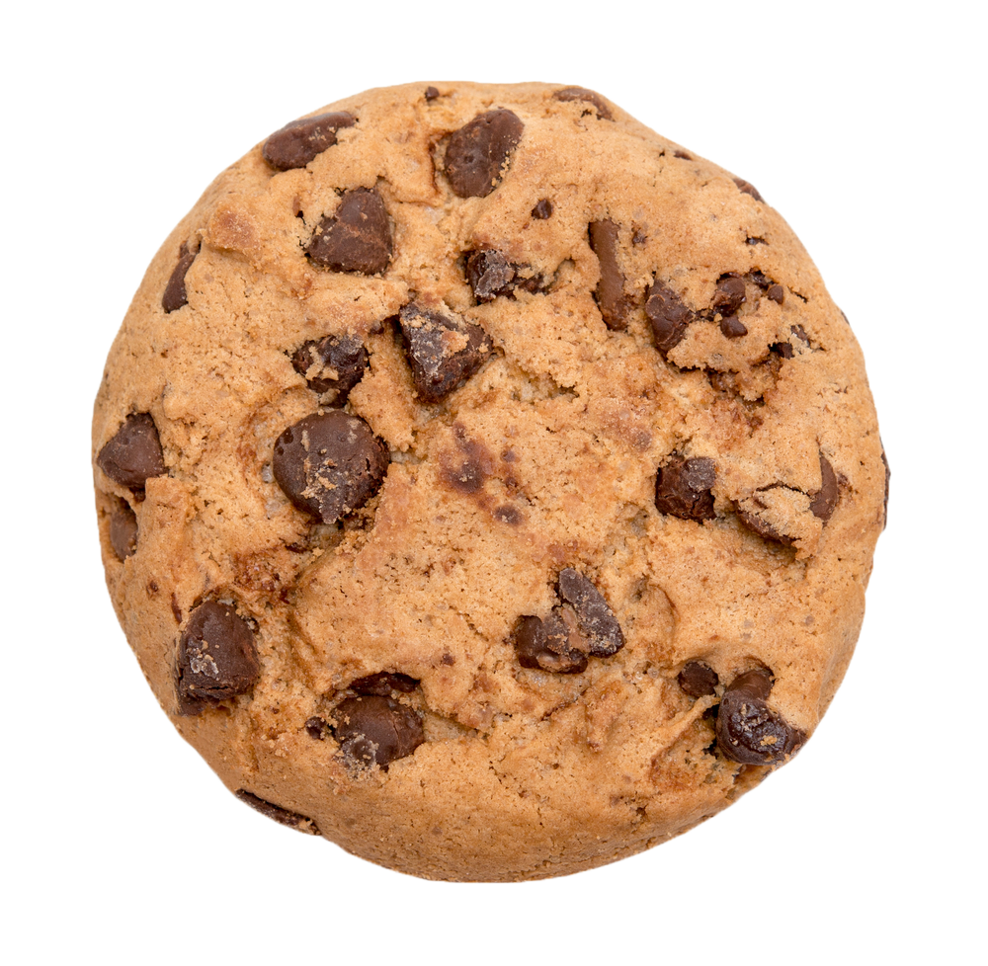

Two Common Attacks
Since sessions still require the use of a potentially vulnerable session ID cookie, they’re susceptible to attack.
Impersonation: Stealing and sending a user’s cookies and/or session ID, so the web application thinks you’re someone else.
Forgery: Creating fake cookies and / or session IDs that
the application understands and interprets “correctly”,
but which lead to unintended behavior.

Slide 26
Tampering Cookies

Slide 27
Gruyere Demo

Slide 28
Student Activity: Manipulating Cookies
In this activity, you will use Gruyere to explore how cookies can be used for authentication and how they and be tampered with.
Instructions sent via Slack
20 Minutes

Slide 29
Manipulating Cookies

Slide 30
Break

Slide 31
Validation
Notes:
Gruyere was vulnerable because it accepted arbitrary user input for the username.
- Explain that the solution to this problem is to prevent users from submitting malicious usernames.
- Explain that preventing users from submitting invalid data is called validation.

Slide 32
Client-side validation prevents the user from sending certain data through a form.
Notes:
For example, Gruyere preventing you from trying to register with long usernames

Slide 33
Why is client-side validation important?
Hint: It’s not all about security?
Notes:
Solution: It prevents normal users from submitting invalid data, which improves the user experience. However, it's easily bypassed, and does not significantly improve security.

Slide 34
Session Hijacking
Notes:
Session Hijacking: Overview
- Explain that server validation, while essential, isn't sufficient to protect against attacks against the server.
- Explain that Session Hijacking is the "fundamental" impersonation attack on session server sessions.
- Remind students that, when using sessions, servers:
- Create a new session object to store user data in
- Tag this new session with an ID
- Send the session ID to the user as a cookie

Slide 35
Anatomy of a Session Attack
Servers will process any request with a correct session cookie, even if it comes from an attacker.
A legitimate user, Jane, log into a baking application and receives a cookie like: SESSID=100
An attacker sends request from his own computer with the cookie SESSID=100
The server responds to the attacker as if they were Jane, because they used a cookie containing the Jane’s session ID.

Slide 36
Anatomy of a Session Attack
Accessing the Victim’s Session ID:
This attack requires knowing the victim’s session ID. Two methods:
Read it through JavaScript
Attackers can read victims’ cookies by exploiting an XSS vulnerability.
Guess: Some servers generate session IDs that are easy to guess.
In this case, attackers can forge session IDs.

Slide 37
httponly
Notes:
In this demonstration, you’ll
-Show that JavaScript can be used to read cookie values
-Show that cookies can be hidden from JavaScript with the httponly option
HTTP Only Demonstration
-Reiterate that a common way for attackers to steal cookies is to read them through malicious JavaScript.
- To demonstrate, return to Gruyere: <https://google-gruyere.appspot.com/start>
-If need be, re-launch an instance.
-Register a new account
-.Open the Developer tools, and point out that your cookies are similar to before.
-Click the Console tab, and run: `document.cookie`. Point out that this prints the same cookie information you saw in the Cookies table.
-In the Dev Tools, select Application, then expand the panes (i.e., pull the Dev Tools open to cover more of the screen). Point out the columns in the cookies table. Call attention to HttpOnly-
-Double-click inside of the HttpOnly cell for the `GRUYERE` cookie, and write `true`.
-Then, return to the Console, and run: `document.cookie`.
-Point out the `GRUYERE` cookie now does _not_ appear.
-Explain that the server can tell the client to store a cookie as HTTP-Only by using the `httponly` option in its response headers.

Slide 38
Weak Session IDs

Slide 39
Student Activity: Weak Session IDs
In this activity, you’ll use BurpSuite to study DVWA’s weak session ID algorithm.
Instructions sent via Slack
20 Minutes

Slide 40
Weak Session IDs

Slide 41
Today’s Objectives
By the end of class, you will be able to:
Define caching and distinguish between private and public caches.
Explain the process behind web cache poisoning
Explain how cookies and sessions provide ways for servers to remember specific information about the client.
Describe two common session attacks: Impersonation and forgery.
Distinguish between client-side and server-side validation.
Explain how session hijacking is an impersonation attack on server sessions.
Discuss why servers often store sensitive, larger, and long-term data in sessions instead of cookies.
Inspect weak session IDs generated by a live web app.
Any Questions ?

